Slide 1
FOOD TRENDS:
Based on Customer Satisfaction
TEAM-05
Under the Guidance:
Pavithra Kannan mam

Slide 2
TEAM MEMBERS:
01
Hema Latha
02
Samvedita Bisariya
03
Dipa Majumder
04
Udit Mathur

Slide 3
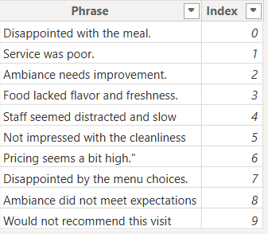
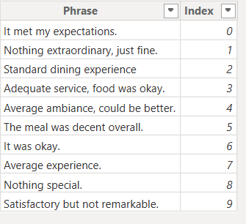
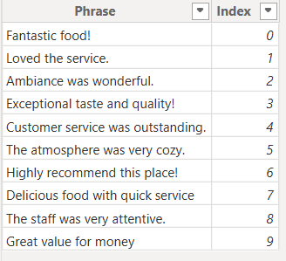
Overview: Sentiment Analysis Dashboard
1. Phrase Tables Created:
Three phrase tables (“Positive,” “Neutral,” “Negative”) were constructed in Power BI as separate tables. Each table lists example phrases or feedback text fragments relevant to its sentiment type.
How we created it:
Manually entered common phrases reflecting each sentiment:
Positive: "Excellent service", "Loved the ambiance", etc.
Neutral: "It was okay", "Average experience", etc.
Negative: "Food was cold", "Long waiting time", etc.
Negative Phrases
Neutral Phrases
Positive Phrases

Slide 4

What Is the Use / Where Is It Used?
Enriches DynamicFeedback Column by appending realistic feedback phrases based on detected sentiment.
Used in DAX formulas and Power Query logic to randomly add phrases to synthetic or real feedback, providing more context or examples in visuals and test cases.
2. Core Columns Created:
SentimentCategory
Classifies sentiment based on rating:
≥4 → Positive, =3 → Neutral, <3 → Negative.
Example Power Query Logic:

Slide 5
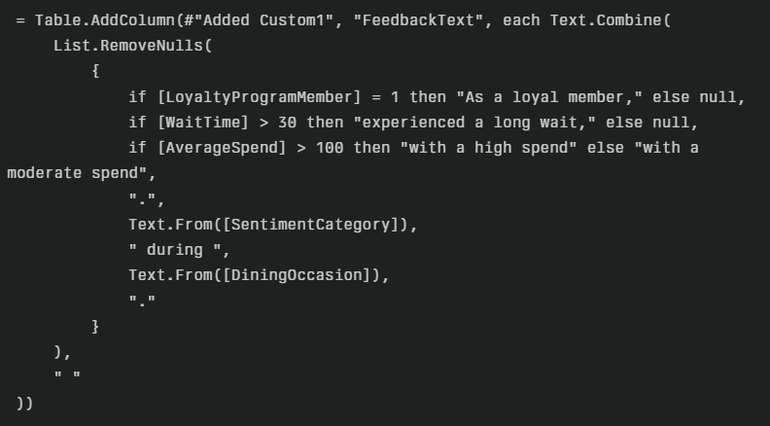
(B) FeedbackText Column:
Combines customer info into a single descriptive sentence.
Includes:
loyalty membership, wait time, spend level, sentiment, dining occasion.
Uses List.RemoveNulls + Text.Combine for clean sentences.
Example Power Query Logic: Feedback

Slide 6
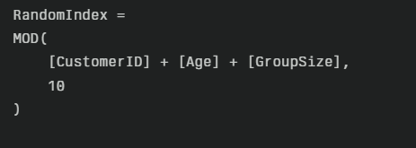
(C) RandomIndex DAX Column:
Formula creates values 0–9 using (CustomerID + Age + GroupSize) % 10.
Provides pseudo-random, reproducible distribution.
Used to select varied phrases for feedback without true randomness.
(D) DynamicFeedback:
Uses phrase tables (Positive, Neutral, Negative).
Based on SentimentCategory + RandomIndex + FeedbackText.
Phrase chosen with SWITCH + LOOKUPVALUE.
Final output = Base text + selected phrase → enriched, dynamic feedback.

Slide 7
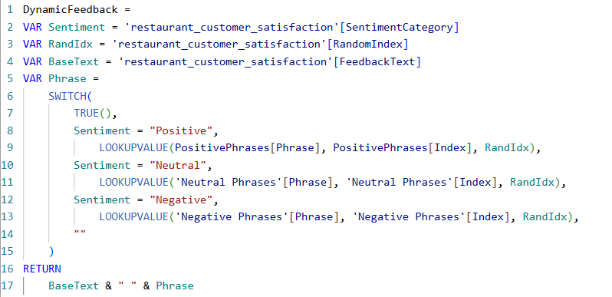
3. AI/NLP Sentiment Classification (VADER in Python):
What We Did:
Used VADER SentimentIntensityAnalyzer to classify customer feedback.
Added two columns in Power BI via Python:
(a) SentimentScore_AI → numeric score (-1 to +1).
(b) SentimentCategory_AI → Positive / Neutral / Negative.

Slide 8
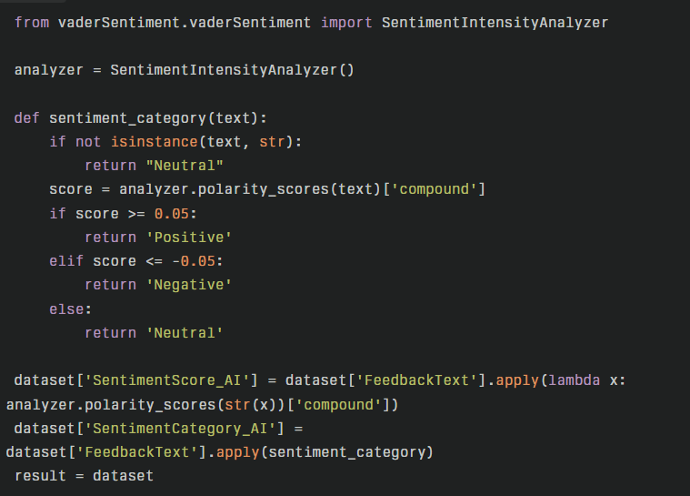
How We Created It:
Enabled Python in Power BI & installed vaderSentiment.
Loaded feedback data into Power Query.
Applied VADER to generate sentiment score.
Classified score:
≥0.05 = Positive, ≤-0.05 = Negative, else Neutral.
5. Used Pandas to populate new sentiment columns.

Slide 9
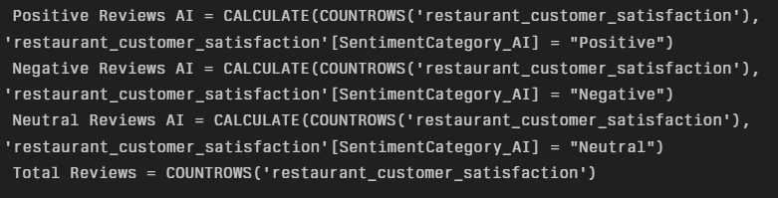
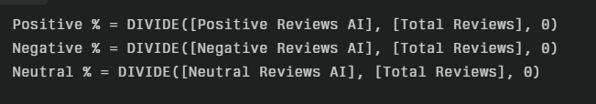

4. DAX Measures for Sentiment Metrics
How We Created It:
Positive/Negative/Neutral Counts:
Percentages:
Average Sentiment Score:

Slide 10
What Is the Use / Where Is It Used?
These measures supply quantitative KPIs for cards and enable all dashboard analytics, including charts, cards, time trends, and segment breakdowns.
Used in all visuals to compare sentiment patterns across categories, time, and filtering scenarios.
5. Power BI Visual Built:
Customer Sentiment Breakdown by Cuisine:
Shows % distribution of Positive, Neutral, Negative reviews for each cuisine.
Helps identify which cuisines perform best/worst in customer perception.
(B) KPI Cards:
Displays Total Reviews, % of Positive, Neutral, Negative feedback.
Provides quick headline metrics for overall sentiment.
Average Sentiment Score Gauge:
Visualizes sentiment score on a scale -1 (negative) to +1 (positive).
Gives a snapshot of the general customer mood.

Slide 11
Reviews by Sentiment (Donut Chart):
Shows overall proportion of reviews by sentiment type.
Easy to see the balance between Positive, Neutral, Negative feedback.
(E) Sentiment by Dining Occasion (Stacked Column Chart):
Breaks down sentiment across Casual, Business, and Celebration dining.
Identifies which occasions generate the most positive or negative responses.
(F) Sentiment by Visit Frequency (Stacked Column Chart):
Analyzes sentiment trends based on how often customers visit.
Helps understand if loyalty affects satisfaction.
(G) Slicers (Filters):
Interactive filters for Meal Type (Dine-in, Takeaway) and Cuisine (e.g., Indian, Italian, Chinese, etc.).
Let's users drill down into specific segments for detailed analysis.

Slide 12
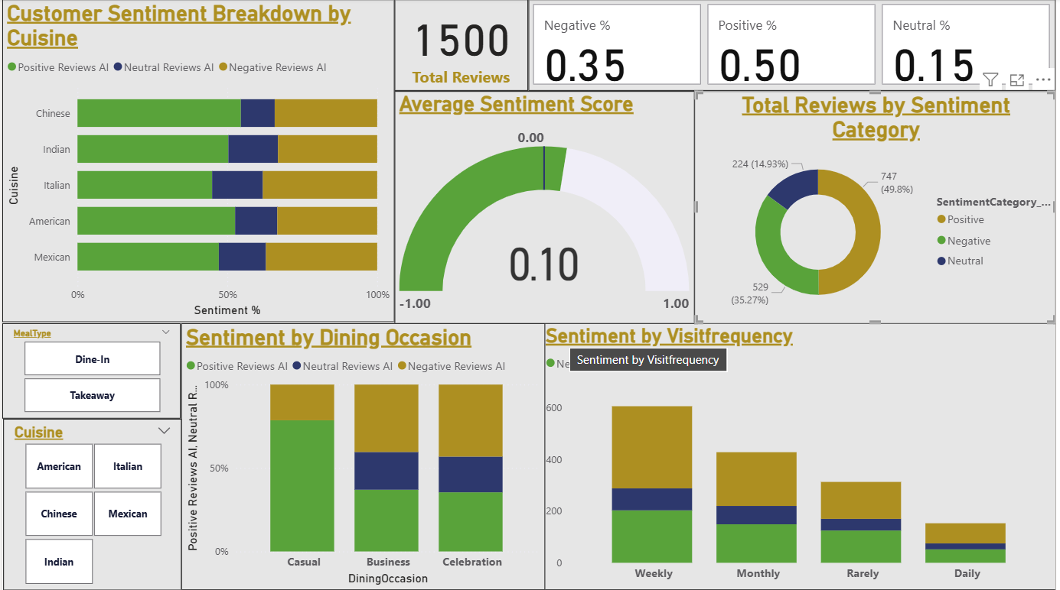

  OUTPUT:

Slide 13
Business Value
Comprehensive Insight: All visuals work together to deliver a full picture of sentiment, from headline KPIs to detailed breakdowns by product, occasion, and customer behaviour.
Interactive Analysis: Slicers allow deep dives into segments, supporting better decision-making.
Clear Communication: The use of percentage and count visuals ensures that both volume and distribution are easy to interpret.
Purpose of the Dashboard
The purpose of this Customer Sentiment Analysis Dashboard is to analyze
and visualize customer feedback in the food industry to:
-- Classify customer reviews into Positive, Neutral, and Negative
sentiments.
-- Understand customer satisfaction trends across different cuisines,
dining occasions, and visit frequencies.
-- Provide actionable insights by visualizing key metrics such as
sentiment distribution, average sentiment score, and total reviews.
-- Help decision-makers quickly identify areas of strength and
opportunities for improvement to enhance customer experience and
optimize restaurant operations.

Slide 14
CONCLUSION
The Customer Sentiment Analysis Dashboard provides a powerful and interactive solution for analyzing customer feedback in the food industry. By combining manual phrase enrichment, AI-driven sentiment classification using the VADER tool, and dynamic DAX measures, the dashboard effectively categorizes customer reviews into Positive, Neutral, and Negative sentiments. It offers clear visualizations of sentiment trends across various dimensions such as Cuisine Type, Dining Occasion, and Visit Frequency. The use of interactive slicers allows users to explore the data flexibly, enabling detailed analysis by Meal Type or Cuisine. Overall, the dashboard helps decision-makers gain actionable insights into customer satisfaction patterns, identify strengths and weaknesses in service delivery, and make data-driven decisions to improve customer experience and optimize business operations.

Slide 15
THANK YOU

